Slide 1
Phân tích và thiết kế thuật toán CS112.N21.KHTN GRAPH ALGORITHMS & APPLICATION Nhóm 14
1

Slide 2


Nguyễn Hoàng Thuận
Lê Thị Liên
Nhóm 14
2

Slide 3

1
1
2
2
3
4
3
4

Slide 4
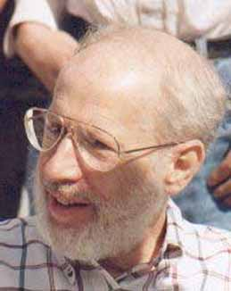

WHO?
4

Slide 5
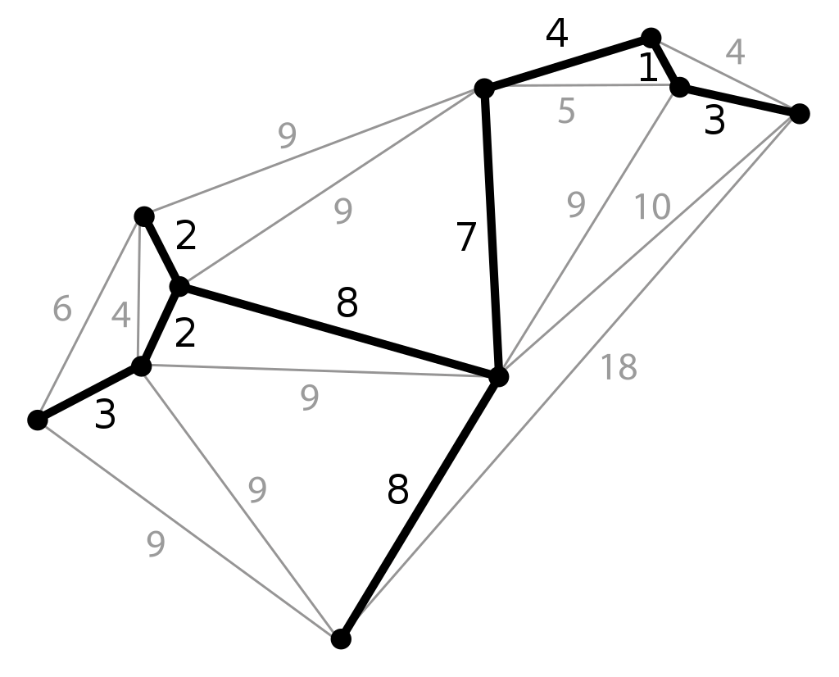
WHAT?
5

Slide 6

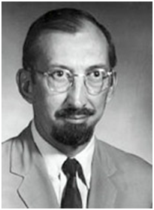
WHO?
6

Slide 7
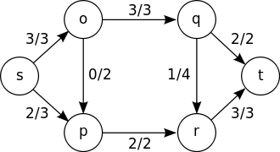
WHAT?
7

Slide 8
GRAPH ALGORITHMS & APPLICATION IN IMAGE SEGMENTATION
Graph Introduction
Algorithms
Application in Image Segmentation
Homework & Quiz
8

Slide 9
I. GRAPH INTRODUCTION
9

Slide 10
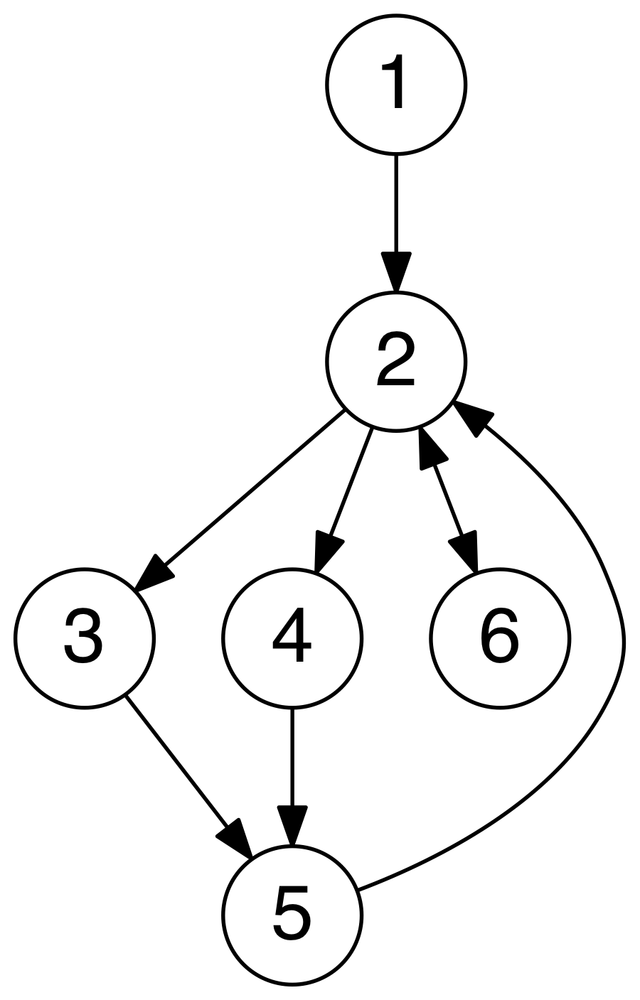
I. GRAPH INTRODUCTION
A Graph is an ordered pair G = (V, E) consisting of a nonempty set V (called the vertices) and a set E (called the edges) of two-element subsets of V.
Undirected Graph: a graph in which the adjacency relation is symmetric. So if there exists an edge from node u to node v (u -> v), then it is also the case that there exists an edge from node v to node u (v -> u)
Directed Graph: a graph in which the adjacency relation is not symmetric. So if there exists an edge from node u to node v (u -> v), this does not imply that there exists an edge from node v to node u (v -> u)
10

Slide 11
I. GRAPH INTRODUCTION
How to represent a graph in the computer?
11

Slide 12
II. ALGORITHMS
12

Slide 13
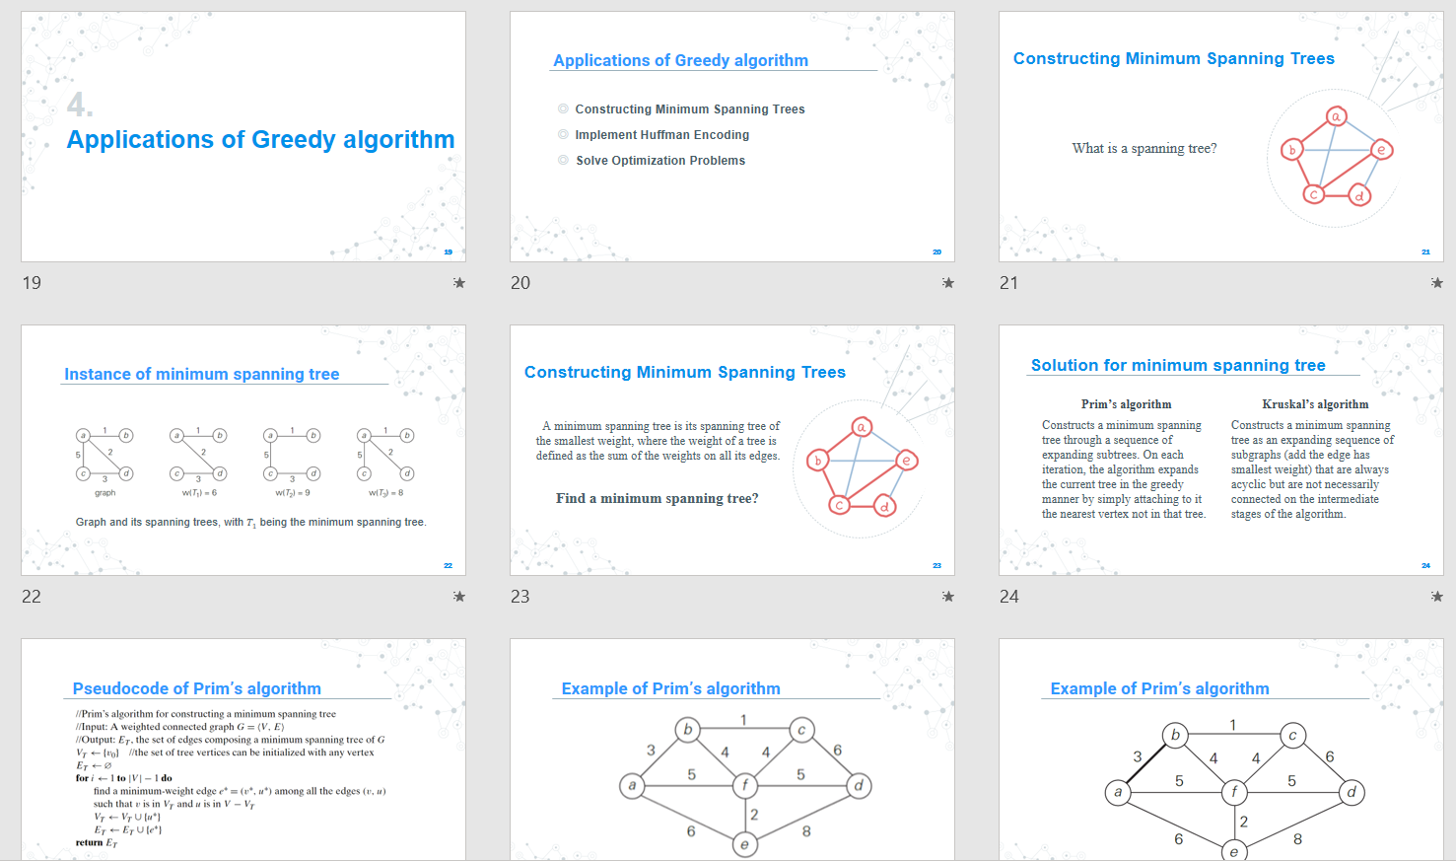


II. ALGORITHMS
2.1. Minimum Spanning Tree
Link : https://github.com/mnt1702/CS112.N21.KHTN
13

Slide 14
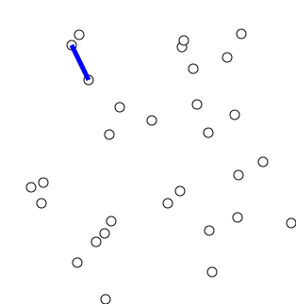
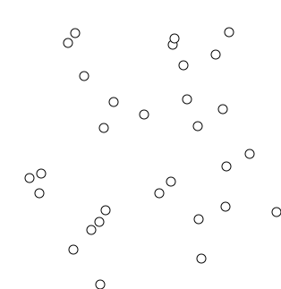
II. ALGORITHMS
2.1. Minimum Spanning Tree
Prim's Algorithm
Kruskal's Algorithm
14

Slide 15
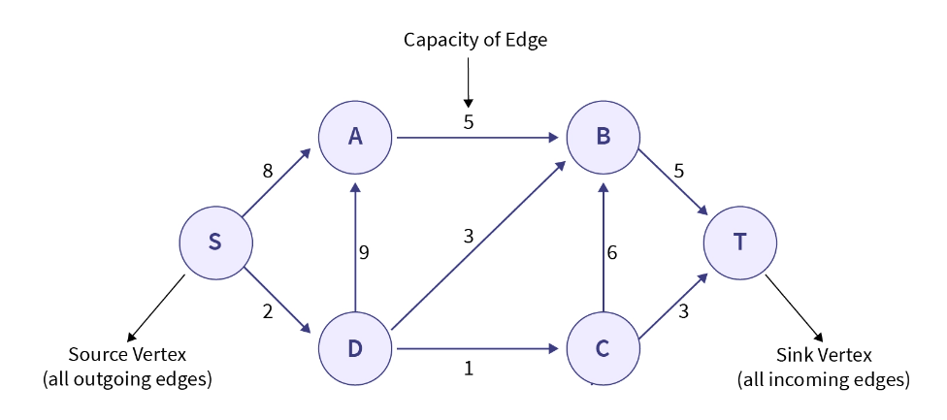
II. ALGORITHMS
2.2. Maximum Flow
Flow Network :
15

Slide 16
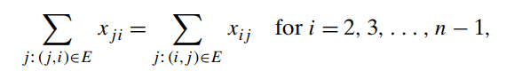
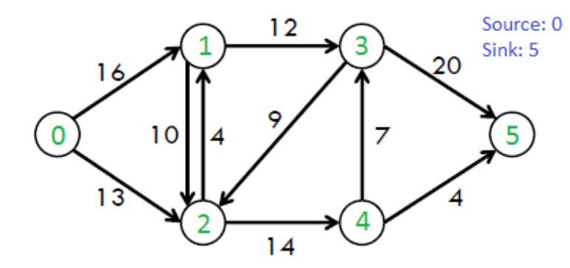
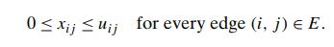
II. ALGORITHMS
2.2. Maximum Flow
Flow :
flow-conservation requirement
Capacity constraints
16

Slide 17
II. ALGORITHMS
2.2. Maximum Flow
Input:
Directed graph with a source node (s) and a sink node (t).
Capacities assigned to each edge in the graph.
Output:
Maximum flow value from the source to the sink.
17

Slide 18
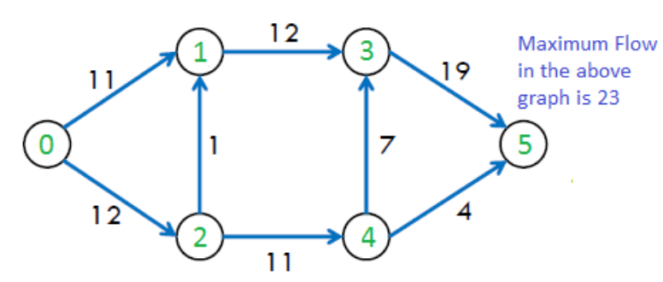
II. ALGORITHMS
2.2. Maximum Flow
Input:
Directed graph with a source node (s) and a sink node (t).
Capacities assigned to each edge in the graph.
Output:
Maximum flow value from the source to the sink.
18

Slide 19
II. ALGORITHMS
2.2. Maximum Flow
2.2.1. Ford-Fulkerson Algorithm
Simple ideas :
Start with initial flow as 0.
While there exists an augmenting path from the source to the sink:
Find an augmenting path using any path-finding algorithm. An augmenting path is a simple path in the residual graph.
Determine the amount of flow that can be sent along the augmenting path, which is the minimum residual capacity along the edges of the path.
Increase the flow along the augmenting path by the determined amount.
Return the maximum flow.
19

Slide 20
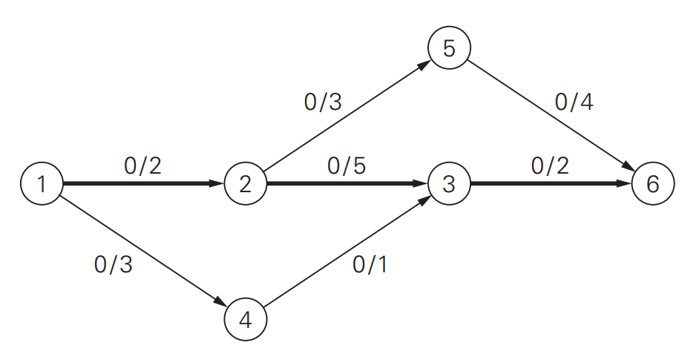
II. ALGORITHMS
2.2. Maximum Flow
2.2.1. Ford-Fulkerson Algorithm
How many paths from source to sink ?
20

Slide 21
II. ALGORITHMS
2.2. Maximum Flow
2.2.1. Ford-Fulkerson Algorithm
residual graph
21

Slide 22
II. ALGORITHMS
2.2. Maximum Flow
2.2.1. Ford-Fulkerson Algorithm
residual graph
22

Slide 23
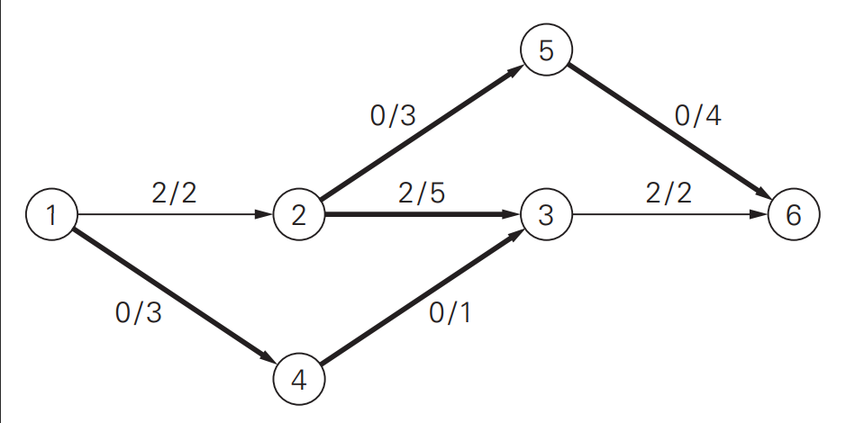
II. ALGORITHMS
2.2. Maximum Flow
2.2.1. Ford-Fulkerson Algorithm
residual graph
23

Slide 24
II. ALGORITHMS
2.2. Maximum Flow
2.2.1. Ford-Fulkerson Algorithm
What is the next augmenting path for the graph?
residual graph
24

Slide 25
II. ALGORITHMS
2.2. Maximum Flow
2.2.1. Ford-Fulkerson Algorithm
residual graph
25

Slide 26
II. ALGORITHMS
2.2. Maximum Flow
2.2.1. Ford-Fulkerson Algorithm
residual graph
26

Slide 27
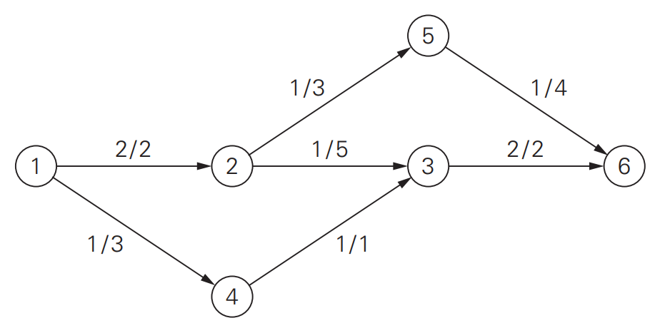
II. ALGORITHMS
2.2. Maximum Flow
2.2.1. Ford-Fulkerson Algorithm
What is the next augmenting path for the graph?
residual graph
27

Slide 28
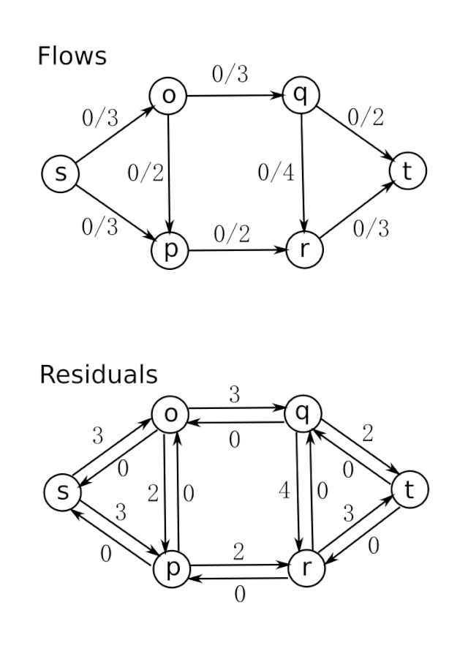
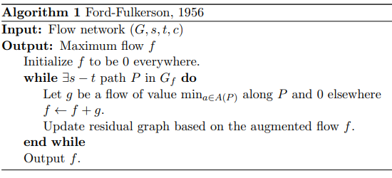
II. ALGORITHMS
2.2. Maximum Flow
2.2.1. Ford-Fulkerson Algorithm
28

Slide 29
II. ALGORITHMS
2.2. Maximum Flow
2.2.1. Ford-Fulkerson Algorithm
Time Complexity:
Time complexity of the this algorithm is O(max_flow * E).
We run a loop while there is an augmenting path. In worst case, we may add 1 unit flow in every iteration. Therefore the time complexity becomes O(max_flow * E).
29

Slide 30
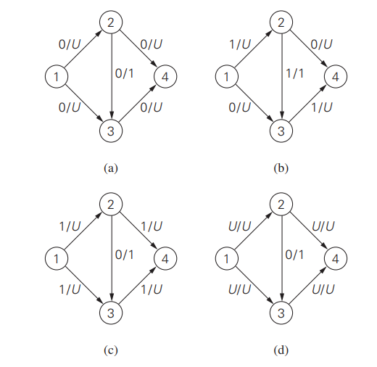
II. ALGORITHMS
2.2. Maximum Flow
2.2.1. Ford-Fulkerson Algorithm
30

Slide 31
II. ALGORITHMS
2.2. Maximum Flow
2.2.2. Edmonds–Karp Algorithm
Similar to the Ford-Fulkerson algorithm.
Selects the augmenting path with the fewest number of edges.
BFS is used.
31

Slide 32
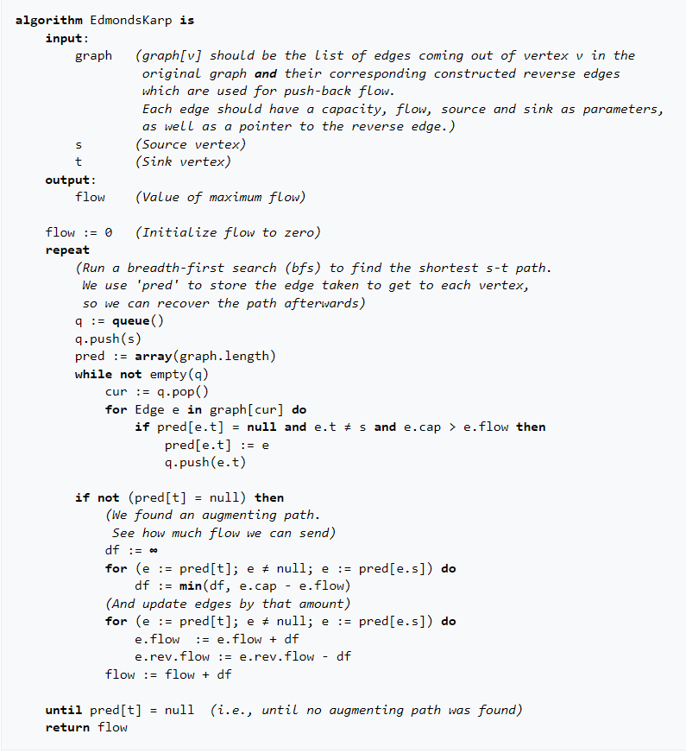
II. ALGORITHMS
2.2. Maximum Flow
2.2.2. Edmonds–Karp Algorithm
Pseudocode
32

Slide 33
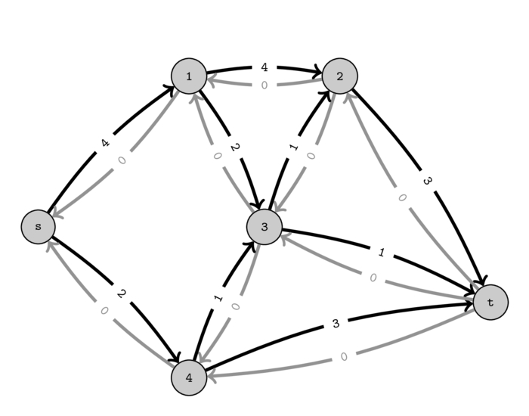
II. ALGORITHMS
2.2. Maximum Flow
2.2.2. Edmonds–Karp Algorithm
33

Slide 34
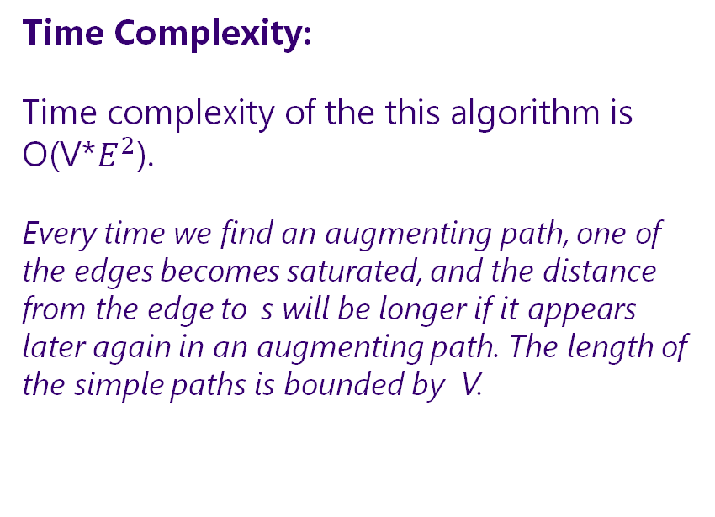
II. ALGORITHMS
2.2. Maximum Flow
2.2.2. Edmonds–Karp Algorithm
Time Complexity:
Time complexity of the this algorithm is O(V*$E^{2}$).
Every time we find an augmenting path, one of the edges becomes saturated, and the distance from the edge to s will be longer if it appears later again in an augmenting path. The length of the simple paths is bounded by V.
34

Slide 35
II. ALGORITHMS
2.2. Maximum Flow
2.2.3. Dinic’s Algorithm
Initialize residual graph G as given graph.
Do BFS of G to construct a level graph (or assign levels to vertices) and also check if more flow is possible.
If more flow is not possible, then return
Send multiple flows in G using level graph until blocking flow is reached. Here using level graph means, in every flow, levels of path nodes should be 0, 1, 2…(in order) from s to t.
35

Slide 36
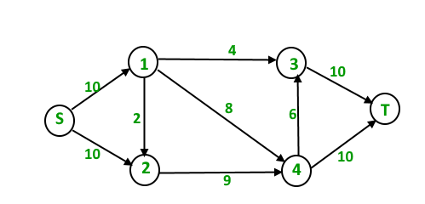
II. ALGORITHMS
2.2. Maximum Flow
2.2.3. Dinic’s Algorithm
36

Slide 37
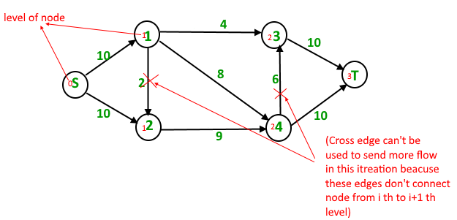
II. ALGORITHMS
2.2. Maximum Flow
2.2.3. Dinic’s Algorithm
37

Slide 38
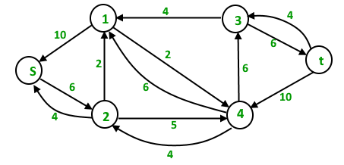
II. ALGORITHMS
2.2. Maximum Flow
2.2.3. Dinic’s Algorithm
4 units of flow on path s – 1 – 3 – t. 6 units of flow on path s – 1 – 4 – t. 4 units of flow on path s – 2 – 4 – t. Total flow = Total flow + 4 + 6 + 4 = 14
residual graph
38

Slide 39
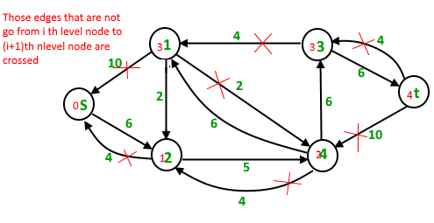
II. ALGORITHMS
2.2. Maximum Flow
2.2.3. Dinic’s Algorithm
residual graph
39

Slide 40
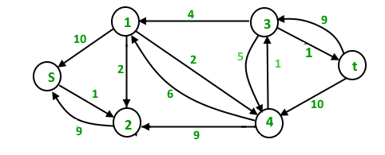
II. ALGORITHMS
2.2. Maximum Flow
2.2.3. Dinic’s Algorithm
5 units of flow on path s – 2 – 4 – 3 – t Total flow = Total flow + 5 = 19
residual graph
40

Slide 41
II. ALGORITHMS
2.2. Maximum Flow
2.2.3. Dinic’s Algorithm
Time Complexity : O(EV²).
Doing a BFS to construct level graph takes O(E) time.
Sending multiple more flows until a blocking flow is reached takes O(VE) time.
The outer loop runs at-most O(V) time.
In each iteration, construct new level graph and find blocking flow. It can be proved that the number of levels increase at least by one in every iteration .So the outer loop runs at most O(V) times.
Therefore overall time complexity is O(EV²).
41

Slide 42
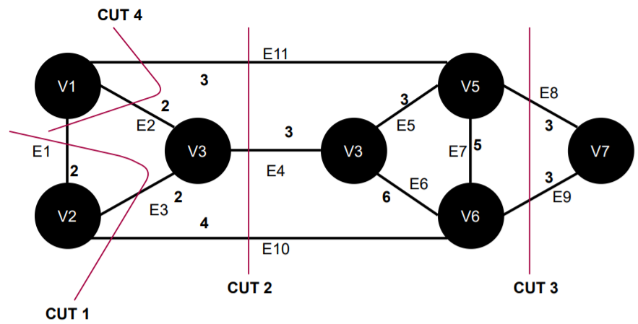
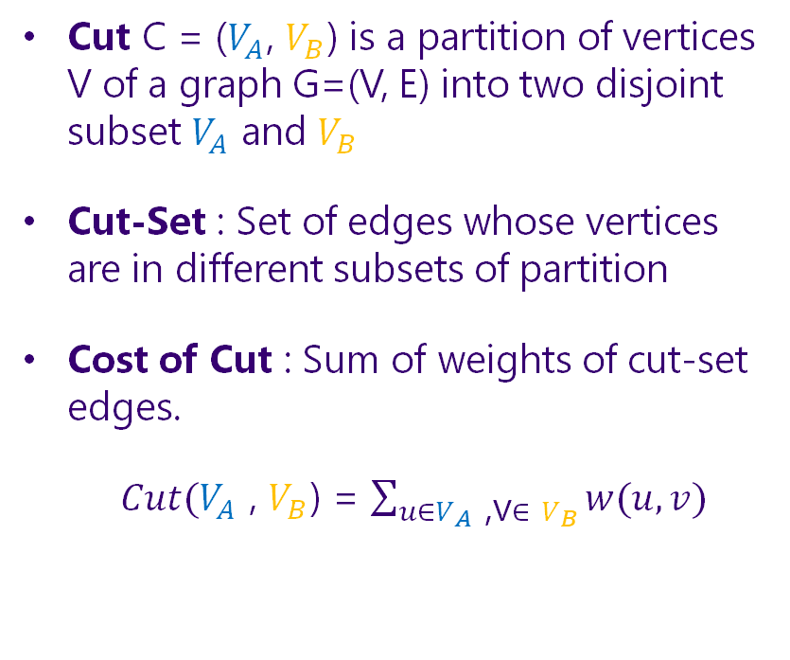
II. ALGORITHMS
2.2. Maximum Flow
2.2.4. Max-flow min-cut theorem
Cut C = ($V_{A}$, $V_{B}$) is a partition of vertices V of a graph G=(V, E) into two disjoint subset $V_{A}$ and $V_{B}$
Cut-Set : Set of edges whose vertices are in different subsets of partition
Cost of Cut : Sum of weights of cut-set edges.
$Cut(V_{A}$ , $V_{B}$) = $\sum_{u∈V_{A}\text{ ,}\text{v}∈ V_{B}}{w(u,v)}$
undirected graph
42

Slide 43
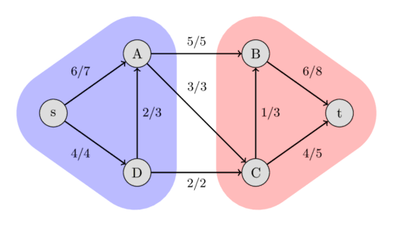
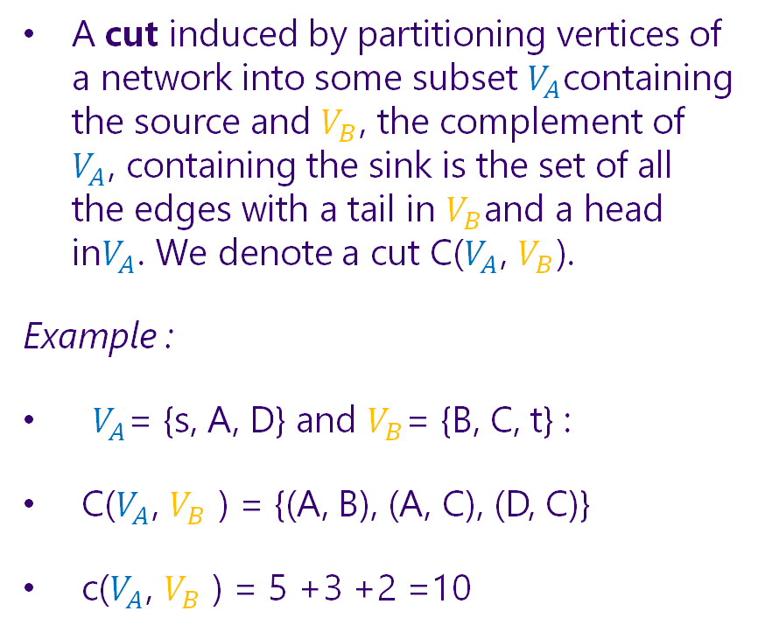
II. ALGORITHMS
2.2. Maximum Flow
2.2.4. Max-flow min-cut theorem
A cut induced by partitioning vertices of a network into some subset $V_{A}$containing the source and $V_{B}$, the complement of $V_{A}$, containing the sink is the set of all the edges with a tail in $V_{B}$and a head in$V_{A}$. We denote a cut C($V_{A}$, $V_{B}$).
Example :
$V_{A}$= {s, A, D} and $V_{B}$= {B, C, t} :
C($V_{A}$, $V_{B}$ ) = {(A, B), (A, C), (D, C)}
c($V_{A}$, $V_{B}$ ) = 5 +3 +2 =10
43

Slide 44
II. ALGORITHMS
2.2. Maximum Flow
2.2.4. Max-flow min-cut theorem
The max-flow min-cut theorem states that the maximum flow through any network from a given source to a given sink is exactly equal to the minimum sum of a cut.
Proof : Anany Levitin, Introduction to the Design and Analysis of Algorithms, 3rd Edition, 2014File
44

Slide 45
II. ALGORITHMS
2.2. Maximum Flow
2.2.4. Max-flow min-cut theorem
Following are steps to print all edges of the minimum cut.
Run the Ford-Fulkerson / Edmonds-Karp / Dinic’s algorithm and consider the final residual graph.
Find the set of vertices that are reachable from the source in the residual graph.
All edges which are from a reachable vertex to a non-reachable vertex are minimum cut edges. Print all such edges.
residual graph
45

Slide 46
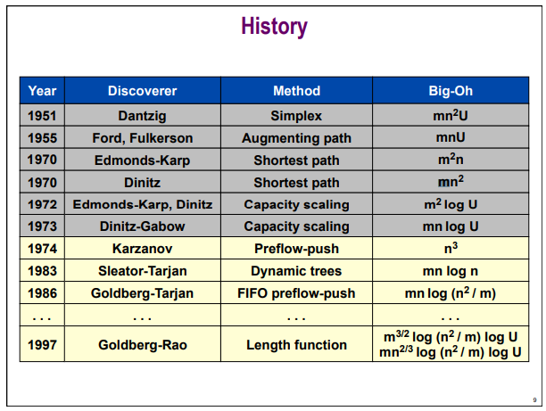
II. ALGORITHMS
https://www.ics.uci.edu/~goodrich/teach/graph/notes/EdmundsKarp.pdf
46

Slide 47
II. ALGORITHMS
References :
https://brilliant.org/wiki/ford-fulkerson-algorithm/
https://www.geeksforgeeks.org/graph-data-structure-and-algorithms/ https://www.ics.uci.edu/~goodrich/teach/graph/notes/EdmundsKarp.pdf
https://github.com/odubno/ford-fulkerson-max-flow
47

Slide 48

Feeling overwhelmed

Slide 49
III. APPLICATION

Slide 50

Warning: This is not CS321

Slide 51
III. APPLICATION
1. Data Clustering

Slide 52
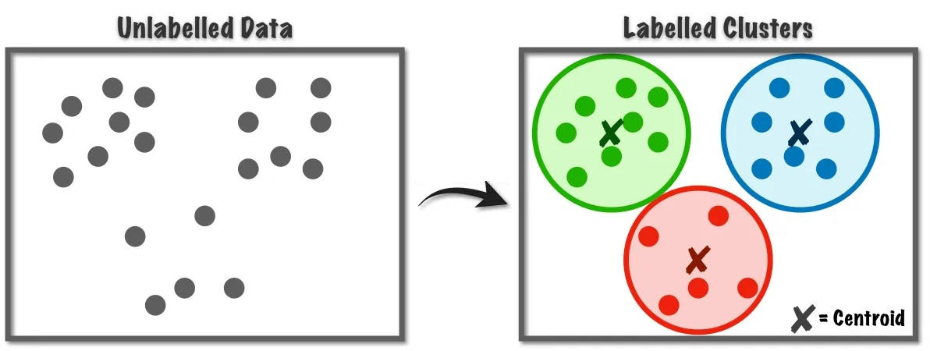
DATA CLUSTERING
“Clustering is the task of dividing the unlabeled data or data points into different clusters such that similar data points fall in the same cluster than those which differ from the others.”
52

Slide 53

Which algorithm has application in clustering problem?
MST CLUSTERING

Slide 54
MST CLUSTERING
Input: N items and the distance d(u, v) between each of pair.
Our Goal: Divide the n items up into k groups so that the minimum distance between items in different groups is maximized.
How to calculate d(u, v) ?
54

Slide 55
MST CLUSTERING
Step 1: Maintain clusters as a set of connected components of a graph.
Step 2: Iteratively combine the clusters containing the two closest items by adding an edge between them.
Step 3: Stop when there are k clusters
=> This is precisely Kruskal’s algorithm !
Something
dejavu?

Slide 56
III. APPLICATION
Data Clustering
2. Image Segmentation

Slide 57

IMAGE SEGMENTATION
“Image segmentation is the process of partitioning a digital image into multiple image segments, also known as image regions or image objects”
INPUT?
OUTPUT?

Slide 58
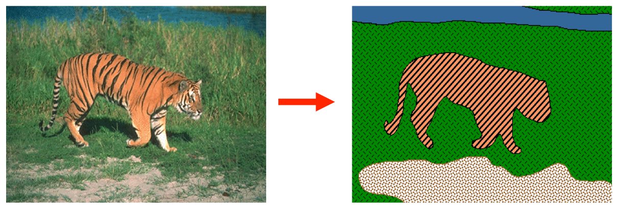
IMAGE SEGMENTATION

Slide 59

IMAGE SEGMENTATION
How to represent images in a computer?
How to represent images in a graph?

Slide 60
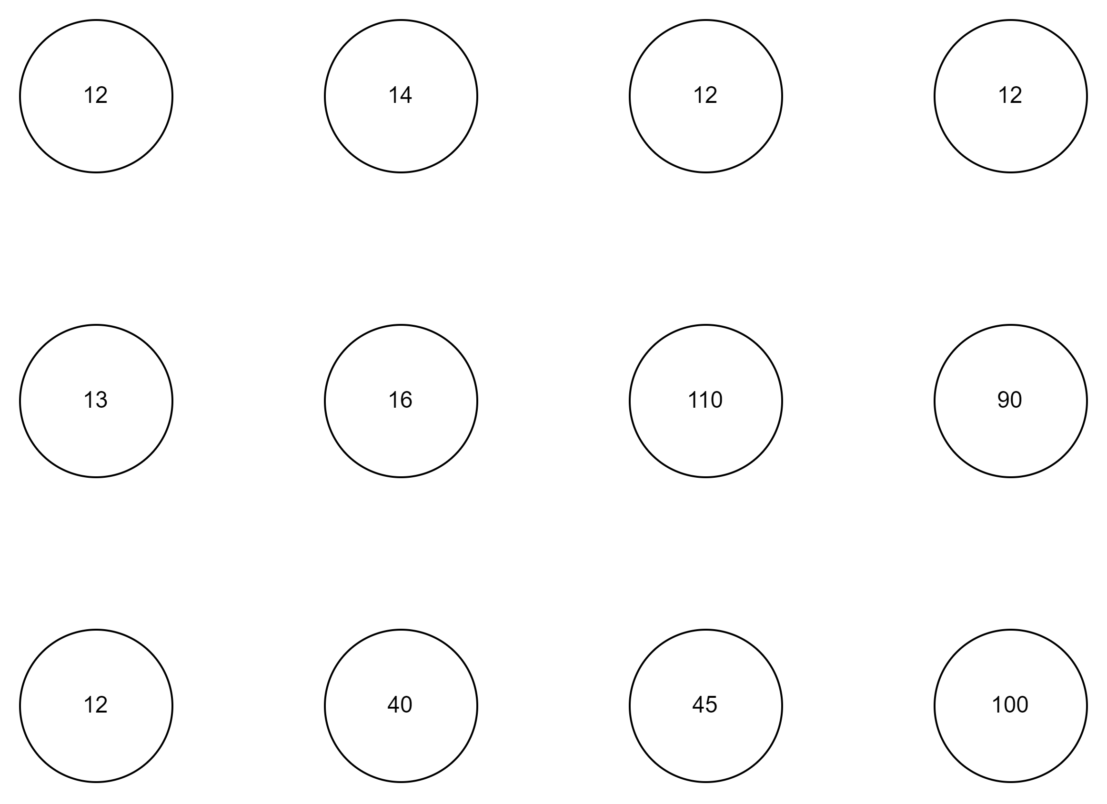

IMAGE REPRESENTATION

Slide 61

IMAGE REPRESENTATION

Slide 62

IMAGE REPRESENTATION

Slide 63
IMAGE REPRESENTATION
WEIGHT?
Notes:
Can you use function B = |I_p – I_q|

Slide 64
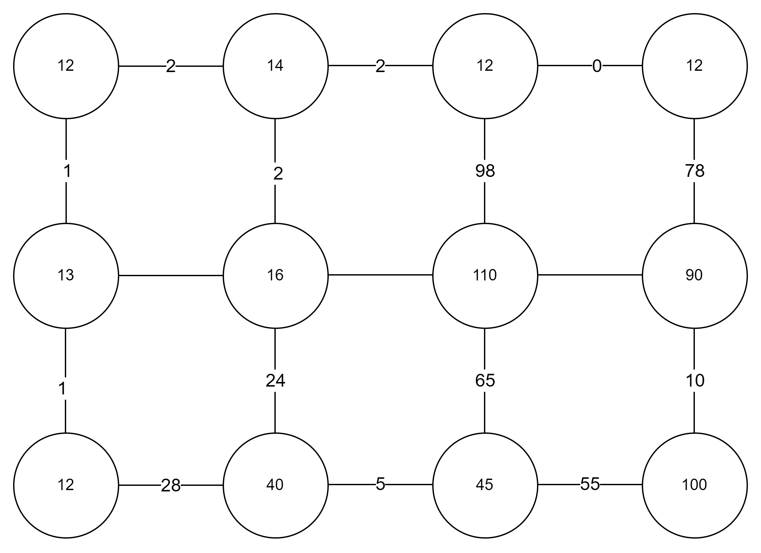
IMAGE REPRESENTATION

Slide 65
IMAGE SEGMENTATION
What method have you learned to solve the image segmentation problem?

Slide 66
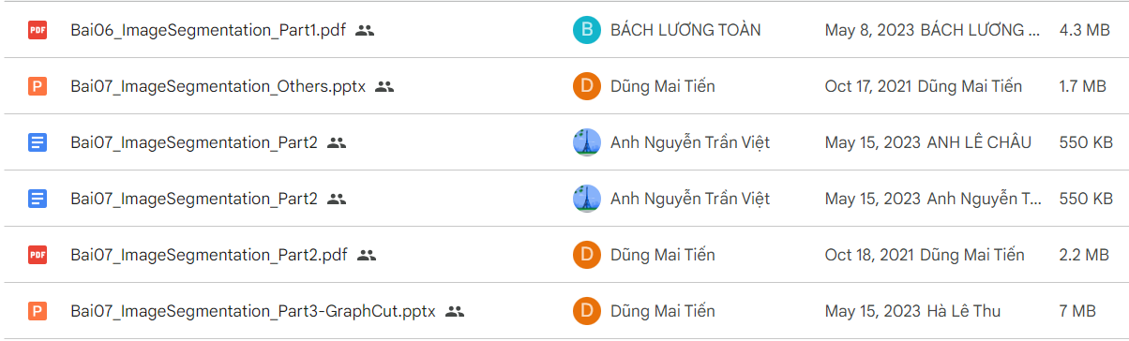

IMAGE SEGMENTATION

Slide 67

MST IMAGE SEGMENTATION

Slide 68
MST IMAGE SEGMENTATION

Slide 69
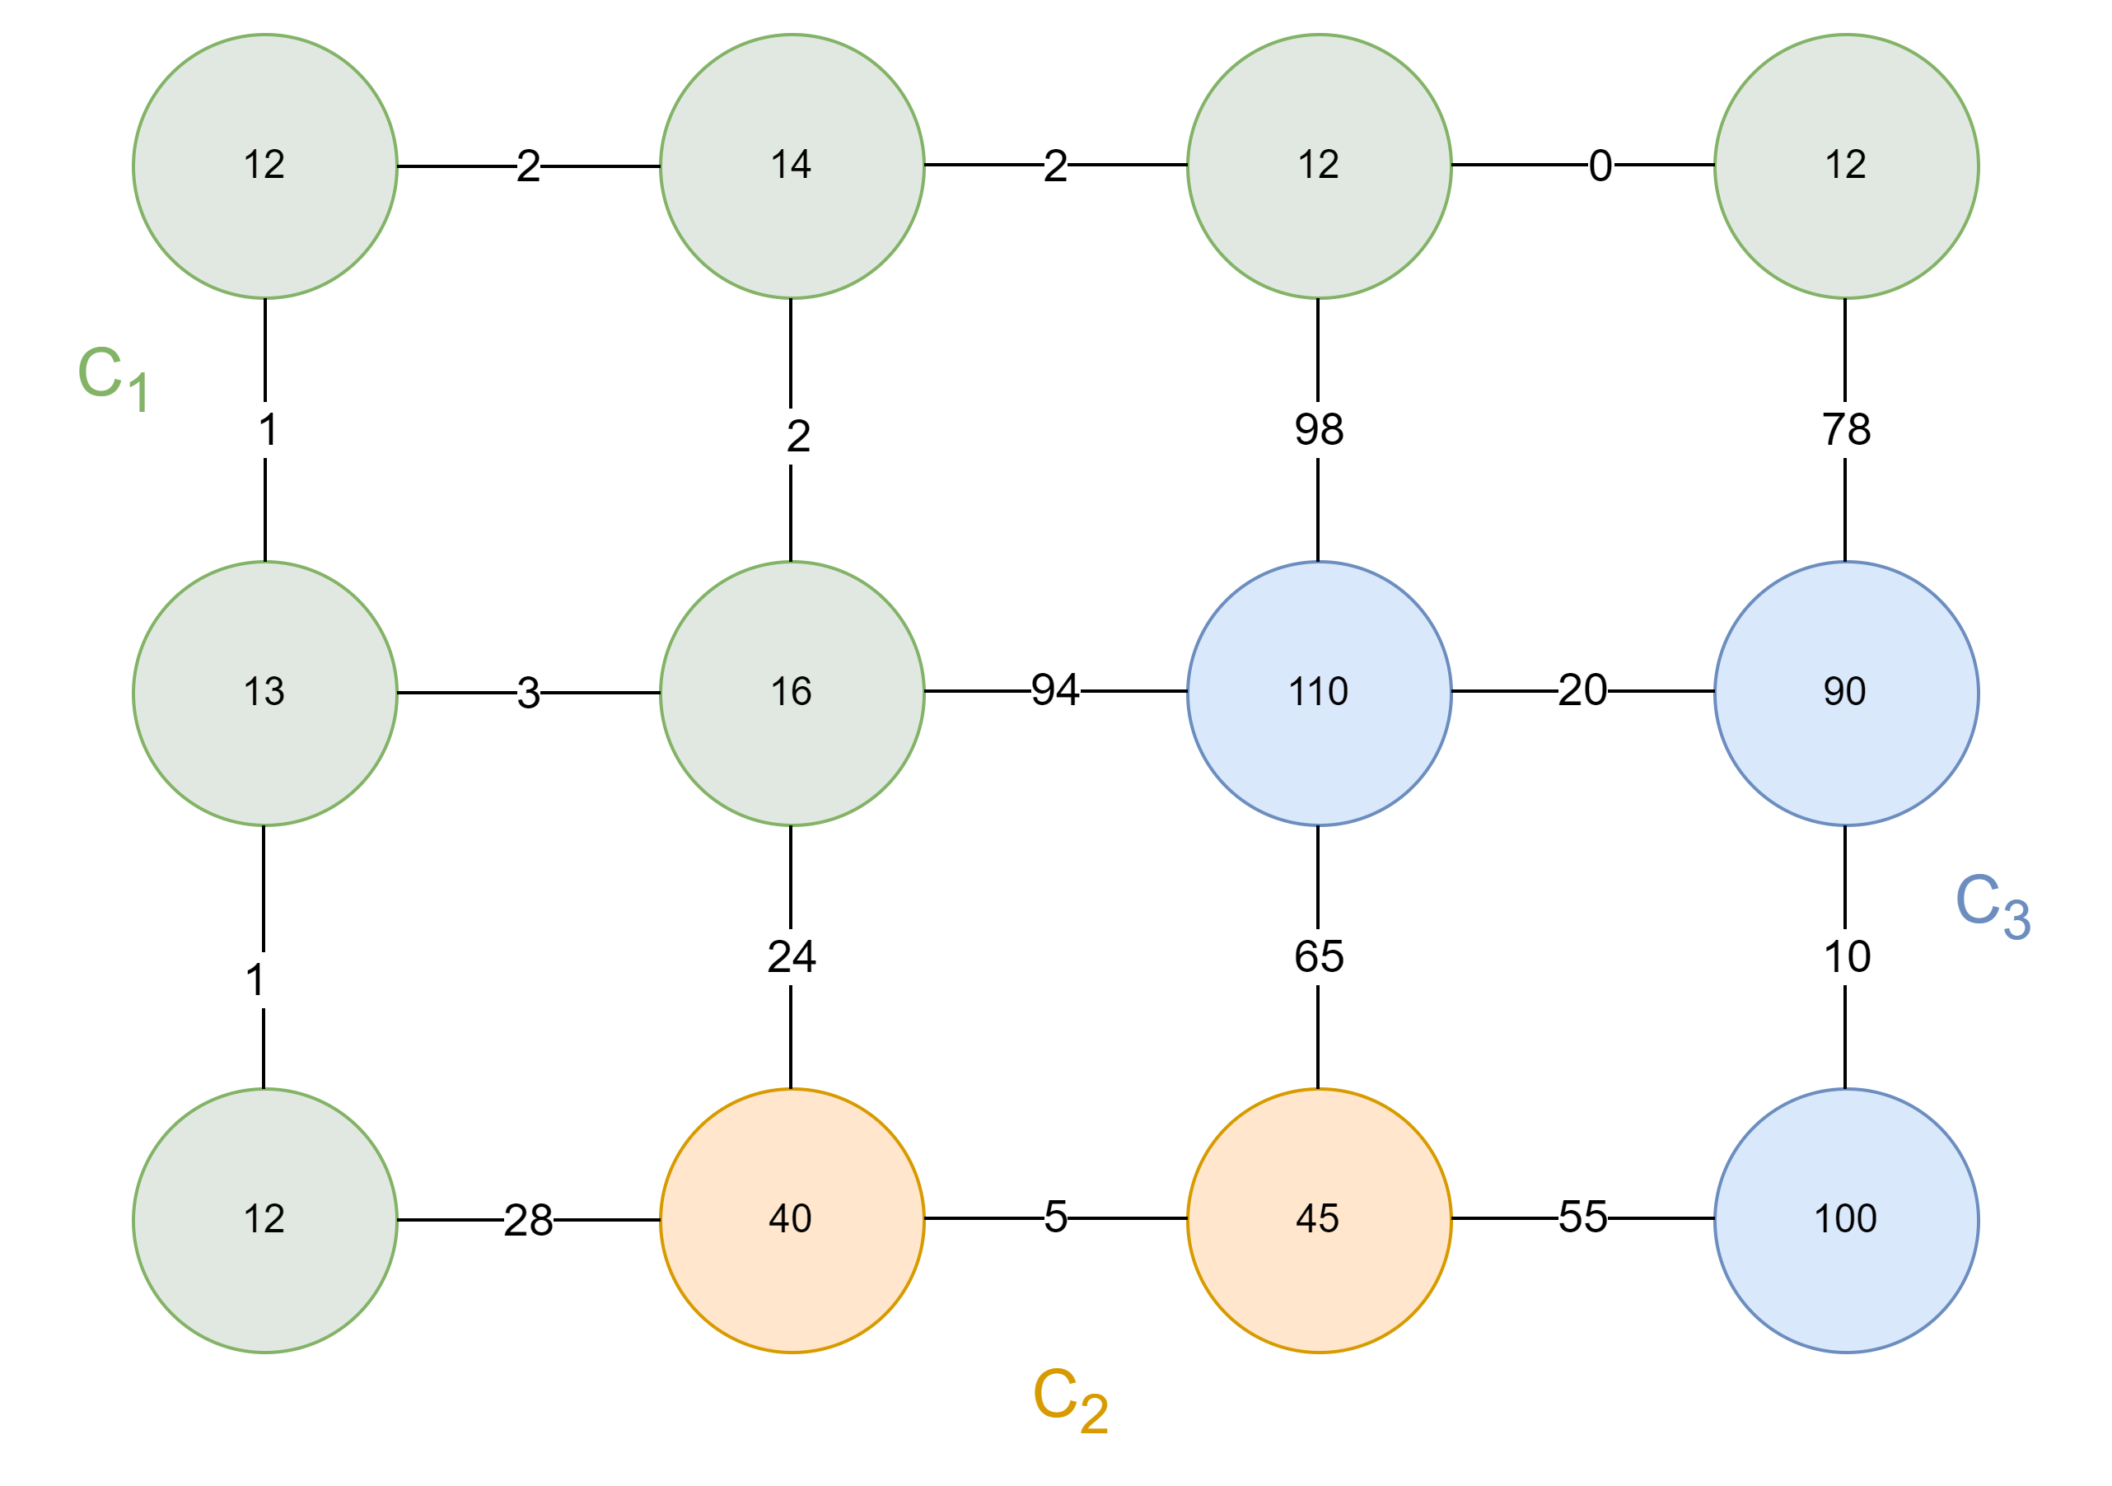
MST IMAGE SEGMENTATION

Slide 70
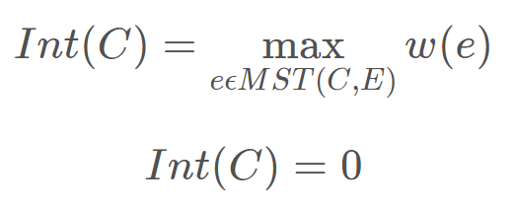
MST IMAGE SEGMENTATION
Internal Diffenrece

Slide 71
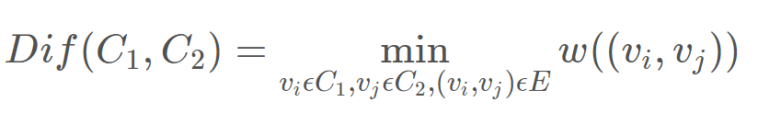
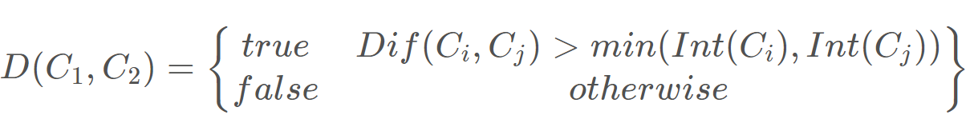
MST IMAGE SEGMENTATION
Component Diffenrece
Boundary Predicate

Slide 72
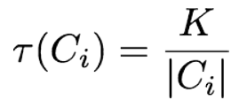
MST IMAGE SEGMENTATION
Boundary Predicate
Threshold Function

Slide 73
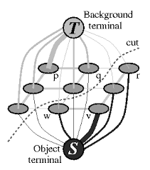
GRAPH CUT

Slide 74
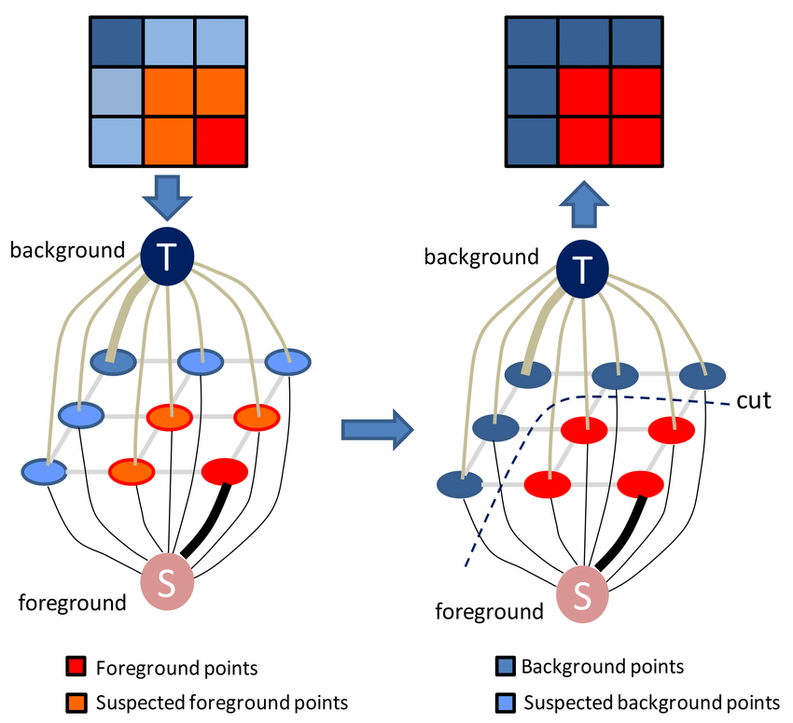

GRAPH CUT
How to representation image in this graph?
What is the main idea of ​​the method?
Notes:
N-link: 4-neighbor
T-link: Node link to source or sink
To facilitate the model to make suitable t-links, the user is prompted to highlight at least one pixel vertex as a background pixel and at least one as a foreground pixel. These pixel vertices are called seeds. For every background seed, an edge is added from the source vertex to the background seed with capacity K defined as follows. W = max(w(I_p, I_q))

Slide 75
IMAGE REPRESENTATION

Slide 76
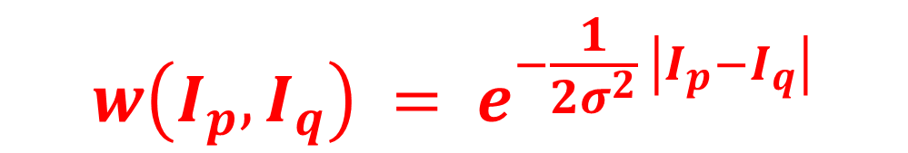

IMAGE REPRESENTATION
Dissimilarity?
Affinity
WEIGHT?
$$w\left(I_{p},I_{q}\right) = e^{−\frac{1}{2σ^{2}} \left|I_{p}−I_{q}\right|}$$
$$w\left(I_{p},I_{q}\right)=\left|I_{p}−I_{q}\right|$$

Slide 77

GRAPH CUT
A pair of vertices from two different subgraph have low affinity
A pair of vertices within a subgraph have high affinity

Slide 78
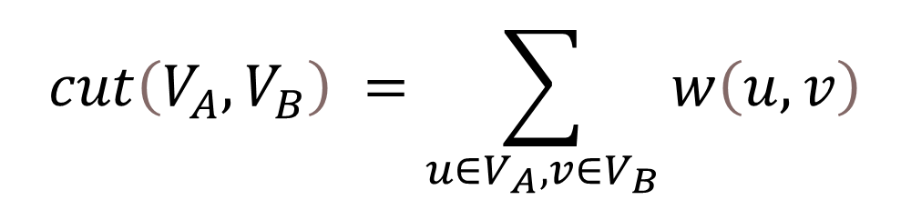
GRAPH CUT
Cost of cut:
$$cut\left(V_{A},V_{B}\right) =\sum_{u∈V_{A}, v∈V_{B}}{w\left(u,v\right)}$$
=> Minimize cost aka Max flow!

Slide 79
GRAPH CUT
THE UP IS REST TO YOU!
Notes:
Can you use function B = |I_p – I_q|

Slide 80
REFERENCES
[1] Vijini Mallawaarachchi: 10 Graph Algorithms Visually Explained, https://towardsdatascience.com/10-graph-algorithms-visually-explained-e57faa1336f3
[2] Geekyrakshit: Efficient Graph-Based Image Segmentation, https://soumik12345.github.io/
[3] Carl Kingsford, University of Maryland, College Park: CMSC 451: Minimum Spanning Trees & Clustering
[4] David Esparza Alba, Ritsumeikan University : Minimum Spanning Tree Segmentation.
[5] Julie Jiang: Image Segmentation with Graph Cuts, https://julie-jiang.github.io/image-segmentation/
Notes:
Can you use function B = |I_p – I_q|

Slide 81
IV. HOMEWORK & QUIZ
81

Slide 82
THANKS FOR LISTENNING
82

